Slide 1
A level
Music
Question 6 Support Guide

Slide 2
Approaches to teaching Question 6
Teachers will have a variety of different and successful approaches to teaching the set works and there is certainly no set way to delivering this part of the course. You may find it helpful to look at the recently produced course planner available on the Pearson A level Music website which shows a possible framework for delivering the specification.
Candidates should get to know the set works and the most important features of the musical elements, but teachers should take care not to over-spend time getting stuck with bar by bar analysis of the pieces. Some of the set works are long, and this level of detail is not required and will not necessarily lend itself well to the discussion-based essay. Focus on the elements, as these are what question 6 is about and help candidates to identify the most salient points.
Explore the historical, social and cultural context of piece. To justify their arguments, candidates will be expected to relate their discussion to other relevant works, as explained in the question.
Spend time listening to examples of music by the same composer, from the same genre, music that students can perform or listen to away from the centre, or that link well with the musical elements.
Your candidates might find it useful to produce a summary sheet once they have studied the set work with the most important musical features of each element (AO3), an explanation of the effect of that feature (AO4) and a link to other music, which is explained and justified (AO4). This information can then be converted in an essay in the style of the exam questions. As good exam preparation, candidates should practise writing their essays in timed conditions.

Slide 3
Advice for answering Question 6
Firstly, allow enough time, this is a 30-mark essay. As a rough guide, try to allow 40 to 45 minutes for this question.
Candidates may complete the exam paper in any order they wish. They should consider attempting the paper in a different order and perhaps start the exam with one of the essays. Try to avoid leaving Questions 5 and 6 to the latter part/end of the exam and writing two consecutive essays.
Candidates should present a well organised essay with an introduction outlining the discussion as well as some background and contextual information about the composer and piece.
They may find it useful to organise the musical elements into paragraphs within this structure. They will need to explain the effect of the musical element and make connections with Other Music and show some knowledge of that piece.
Candidates are advised not to refer to bar numbers in their essays, as this can compromise the fluency of their discussion.

Slide 4
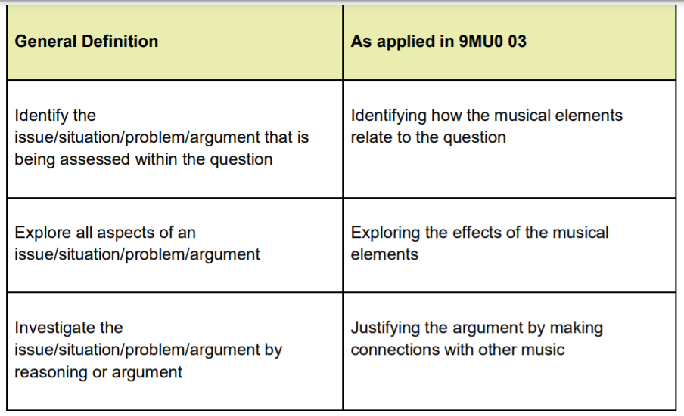
‘Discuss’ as a command word

Slide 5
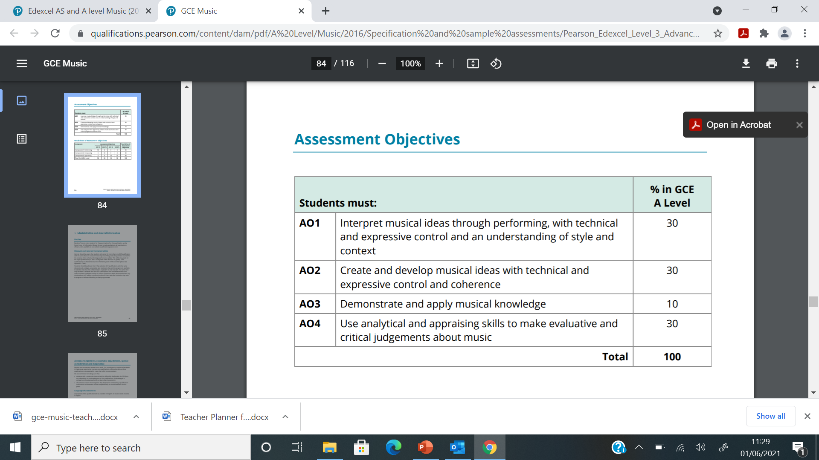
Assessment Objectives 3 and 4
This question covers Assessment Objectives 3 and 4. The weighting for these is set up within the construction of the question and the mark scheme (10 marks AO3, 20 marks AO4). However examiners do not consider the Assessment Objectives separately. Instead they mark holistically and match the descriptors in the assessment grids. Assessment Objective 3 (AO3) covers the knowledge acquired of the musical elements of the set works. Assessment Objective 4 (AO4) covers the analysis of the effect of these elements, and it is expected that each analytical explanation will be justified with reference to other relevant works (see ‘Other Music' section below). Three elements are specified in each question and candidates should cover all three. The nature of the set works may mean that there is more to say about some elements than others but this is taken into consideration when the examination is designed and assessed.
Indicative content (all AO3) is provided in the mark scheme to assist the examiners. There is no expectation that any candidate would make every point listed here; they are simply examples of what are the most likely accurate observations. The potential responses are so large that any indicative content for AO4 would be impractical, therefore this is left to the professional judgement of the examiners, who are trained and standardised in applying the mark scheme accurately. It must be emphasised that this question is assessed against a levels-based mark scheme rather than a points-based one. A candidate producing a long list of features of the music, even if all are relevant to the question, without explanation of effect, and without justification with other music, will be less successful than a candidate making fewer points that are fully explained and justified with other relevant works.

Slide 6
Other music in Question 6
The ability to relate the set works to other music is integral to both the question paper and mark scheme for Question 6. The question states: ‘Relate your discussion to other relevant works. These may include set works or other music.’
The question requires candidates to relate to other relevant works to justify their points. These could be taken from the set works that they have studied or any other music.
These other works should be included in the discussion to justify the musical points being made. Candidates are expected to identify something in the music, to describe or explain its effect, and to justify this explanation with reference to other music. This is reflected in the wording of the assessment criteria.
The best candidates, when referencing other music, will specifically link the effect of the other music to the music heard, rather than simply listing another, similar piece.

Slide 7
Other music in the marking criteria
Level 1 will have little attempt to link to other relevant works. This might mean that they don’t refer to any other music at all in the essay or perhaps just make one other music connection. Perhaps the connection is vague and just mentions a composer.
In Level 2: Attempts are made to refer to other works, with some errors/inconsistency. In this case, some links are made to other music but are perhaps inconsistent throughout the essay, this could be for some and not all of the elements. The choices of other music pieces may be less useful.
Level 3: Relevant works are used to illustrate. This would be where links are made but they are illustrations and not justifications, which would mean simply naming the piece and composer rather than explaining the link and showing knowledge of that linked piece.
Level 4: Relevant works are used to justify. Here it would justify the other music connection by showing knowledge of that piece which led them to make a connection.
Level 5: Relevant works are used to justify salient points. In these cases examples would identify the most important points to justify and explain in order to construct a well-balanced discussion in their essay.

Slide 8
Other music in the essay
Give examples of other music for each element
Keep it balanced and try to give examples justified by reference to other music
Not every musical point needs another music reference
Put other music references alongside the musical feature and not as general other music at the end of the essay or paragraph
Give specific references to other music beyond only the name of a composer or specific movement if a large work
More effective to keep other music varied rather than limiting to one work throughout an essay
Incorporate other music fluently into the essay so it becomes a discussion.

Slide 9
Introductions and Conclusions
An introduction is necessary and ideal for context about the composer and piece.
Keep context musically relevant.
Include: the date of composition, where and why, other pieces written by the composer around that time.
Candidates might like to refer to the nationality of the composer, when they were composing, and their style or similar pieces composed around the time of the set work.
Do not use the introduction to repeat the essay title.
A conclusion is not necessary unless you have some new information to include.

Slide 10
Candidate responses– level 2
INTRODUCTION
Stravinsky was a Russian composer born in 1882 and died in 1971. He was part of the neoclassical era which focused on contrast and nationalism, the opposite to the Romantic era. The Rite of Spring was composed in 1913 and is a ballet. It is about the sacrifice of a young girl and this first caused riots due to the storyline and choreography. I will be focusing on unconventional harmony, chaotic texture and fast syncopated tempo, mete and rhythm. Wider listening will include Stravinsky’s Firebird, Bernard Herrmann’s Psycho (Prelude) and Tchaikovsky’s Swan Lake.

Slide 11
Candidate responses– level 2
INTRODUCTION
Stravinsky was a Russian composer born in 1882 and died in 1971. He was part of the neoclassical era which focused on contrast and nationalism, the opposite to the Romantic era. The Rite of Spring was composed in 1913 and is a ballet. It is about the sacrifice of a young girl and this first caused riots due to the storyline and choreography. I will be focusing on unconventional harmony, chaotic texture and fast syncopated tempo, mete and rhythm. Wider listening will include Stravinsky’s Firebird, Bernard Herrmann’s Psycho (Prelude) and Tchaikovsky’s Swan Lake.
In this introduction the candidate had learnt the dates and nationality of the composer, although there was some confusion about Neoclassical, which is not relevant to this work. There is a general description of the storyline and first performance. There is no need to repeat the three elements of the question and it’s not the place to present musical vocabulary. Leave this until the paragraph for each element when AO3 vocabulary can be discussed with AO4 explanation of effects created. There is no need to mention wider listening at this stage, unconnected to any musical features. This would be a low level 2 introduction as it makes general links between the music and context but there is not sufficient musical information to achieve a mark in a higher level.

Slide 12
Candidate responses– level 4
INTRODUCTION
The Rite of Spring was composed in 1913 by Russian composer Igor Stravinsky as the third in a series for the Ballet Russes company, the first being The Firebird in 1910, followed by Petroushka in 1911. He was commissioned by the famous director Diagalev after he heard Stravinsky’s orchestral piece Fireworks in 1908, a wedding present for his teacher and mentor Rimsky Korsakov, and was impressed. Roerich created the story for the ballet, that was unlike previous Romantic Russian ballets. The Rite of Spring describes Pagan Russia with the sacrifice of a young girl who dances herself to death. Together with primitive dissonant music and Nijinsky’s non-traditional ballet choreography, it sparked a shocking and riotous reaction from the audience at it’s premiere in Paris in 1913.

Slide 13
Candidate responses– level 4
INTRODUCTION
The Rite of Spring was composed in 1913 by Russian composer Igor Stravinsky as the third in a series for the Ballet Russes company, the first being The Firebird in 1910, followed by Petroushka in 1911. He was commissioned by the famous director Diagalev after he heard Stravinsky’s orchestral piece Fireworks in 1908, a wedding present for his teacher and mentor Rimsky Korsakov, and was impressed. Roerich created the story for the ballet, that was unlike previous Romantic Russian ballets. The Rite of Spring describes Pagan Russia with the sacrifice of a young girl who dances herself to death. Together with primitive dissonant music and Nijinsky’s non-traditional ballet choreography, it sparked a shocking and riotous reaction from the audience at it’s premiere in Paris in 1913.
This is a good introduction. The candidate refers to the date of composition and other ballets written by Stravinsky around that time. There is awareness of the collaboration of composer, director, writer and choreographer. They show knowledge of the storyline and the events surrounding the first performance. This would be a level 4 introduction showing detailed links between the music and the historical, social and cultural context in which it was created and developed. If the candidate had referred to context throughout the essay with understanding of Stravinsky’s style, in conjunction with discussion, this would become Level 5 demonstrating sophisticated links.

Slide 14
Marking Question 6
How to award marks
The indicative content provides examples of how students will meet each skill assessed in the question. The levels descriptors and indicative content reflect the relative weighting of each skill within each mark band.
Finding the right level
The first stage is to decide which level the answer should be placed in. To do this, examiners use a ‘best-fit’ approach, deciding which level most closely describes the quality of the answer. When considering the level, examiners work down from level 5. Answers can display characteristics from more than one level, and where this happens markers must use the guidance below and their professional judgement to decide which level is most appropriate. If a candidate's answer matches a level descriptor precisely it is placed at the top of that level. Marks at the bottom of a level often have features relating to the level below.
When marking, examiners will be considering the accuracy of the indicative content and coverage across the elements, and spend time understanding the candidates explanations of the effect of the musical features and how they link to the question. Links made to other music and how these are used to illustrate or justify the musical observations will follow. It is the examiner’s task to consider all of these against the holistic levels-based mark scheme.

Slide 15
Examples of actual candidate responses
June 2022 exam paper
Question 6d
New Directions
Discuss Stravinsky’s use of harmony, texture and tempo, metre and rhythm in The Rite of Spring: The Augurs of Spring.
Relate your discussion to other relevant works. These may include set works or other music.
Notice the important command word of ‘discuss’ and later reference to ‘your discussion’. This is crucial in the success of the essay integrating the AO3 indicative content with the AO4 explanations and other music. Reference to other relevant works is an integral part of the question wording and examples should appear throughout the essay and for each musical element.

Slide 16
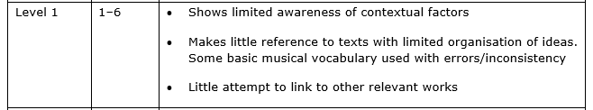
Level 1
It is likely that a level 1 essay will lack background information about the composer, piece and circumstances of composition, or perhaps just give brief background facts. Some basic musical vocabulary will be used, perhaps with errors or with inconsistency throughout the essay. The essay will lack explanation of the effect of the musical features. No references will be made to other music or perhaps makes a very general link.

Slide 17
Candidate responses – level 1
HARMONY
Stravinsky’s use of harmony aided him in turning away from traditional western functionality, instead of being functional, diatonic and ultimately pleasant sounding. Harmony in the Augurs of Spring is non-functional and at places highly dissonant and unpleasant sounding. Similar effects can be seen in Wojciech Kilar’s works which are unconventional and dissonant in areas which are also unconventional and dissonant in areas, notably meeting a similar response from audiences.

Slide 18
Candidate responses– level 1
HARMONY
Stravinsky’s use of harmony aided him in turning away from traditional western functionality, instead of being functional, diatonic and ultimately pleasant sounding. Harmony in the Augurs of Spring is non-functional and at places highly dissonant and unpleasant sounding. Similar effects can be seen in Wojciech Kilar’s works which are unconventional and dissonant in areas which are also unconventional and dissonant in areas, notably meeting a similar response from audiences.
There is basic use of musical vocabulary in this harmony paragraph. They only identify the vocabulary non-functional and dissonant and it lacks musical content about the element. There is a basic attempt to explain the effect of dissonance as being unpleasant sounding. There is little attempt to link to other relevant works with reference only to a composer and not a specific piece.

Slide 19
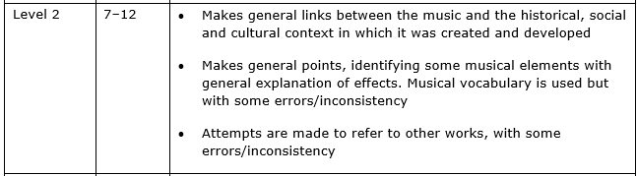
Level 2
For a level 2 essay it is typical that candidates will make general background facts about the composer, piece and circumstances of composition. They will make musical points, identifying some musical elements with general explanation of effects. General musical vocabulary is used but perhaps with errors or inconsistency throughout the essay. General explanation of the effect of the musical element will be made but lacking in detail. Some references will be made to other music but inconsistently throughout the essay or with errors in the choice of linked piece.

Slide 20
Candidate responses– level 2
HARMONY
The opening of the Augurs of Spring has dissonant Eb and Fb chords that create a clashing of harmony showing the awakening of Spring after a long cold winter. This can be compared to Bernard Herrmann's Murder from Psycho with stabbing clashing chords with high pitched strings. A lot of the harmony is based on chromatic chords, bitonality and extended chords, making the harmony unconventional. This can also be seen in Stravinsky’s ballet The Firebird.

Slide 21
Candidate responses– level 2
HARMONY
The opening of the Augurs of Spring has dissonant Eb and Fb chords that create a clashing of harmony showing the awakening of Spring after a long cold winter. This can be compared to Bernard Herrmann's Murder from Psycho with stabbing clashing chords with high pitched strings. A lot of the harmony is based on chromatic chords, bitonality and extended chords, making the harmony unconventional. This can also be seen in Stravinsky’s ballet The Firebird.
The candidate has identified dissonant chords and understands that they are bitonal, even if there is some misunderstanding about the specific chords. They present the information as a list of vocabulary with a mix of correct and incorrect terminology, making general points, rather than achieving a discussion. There is an attempt to refer to other music, but it isn’t clear which of the musical features they are connecting with.

Slide 22
Candidate responses– level 2
TEMPO, METRE AND RHYTHM
There are no metric shifts in the Augurs of Spring and it remains in 2/4 throughout. This is uncommon as in the rest of the Rite of Spring there are metre changes. The driving quaver rhythm helps to provide a consistent tempo and pulse and this does not speed up despite the off beat rhythms making it seem to speed up. There is lots of syncopation in this piece. At the start, the off beat horn interjections create syncopation but later on it is created by complex rhythms such as scotch snaps, triplets and sextuplets. In bar 104 there are cross rhythms created by complex rhythms against simple rhythms which unsettles the pulse and makes it seem syncopated. Beethoven uses this in the first movement of his Pathetique Sonata, though it is less effective as there is only one instrument playing.

Slide 23
Candidate responses– level 2
TEMPO, METRE AND RHYTHM
There are no metric shifts in the Augurs of Spring and it remains in 2/4 throughout. This is uncommon as in the rest of the Rite of Spring there are metre changes. The driving quaver rhythm helps to provide a consistent tempo and pulse and this does not speed up despite the off beat rhythms making it seem to speed up. There is lots of syncopation in this piece. At the start, the off beat horn interjections create syncopation but later on it is created by complex rhythms such as scotch snaps, triplets and sextuplets. In bar 104 there are cross rhythms created by complex rhythms against simple rhythms which unsettles the pulse and makes it seem syncopated. Beethoven uses this in the first movement of his Pathetique Sonata, though it is less effective as there is only one instrument playing.
This candidate understands that the piece is in 2/4 but there is confusion about there being no changes of metre. Examples of other music can only be credited in discussion if the musical feature is correct. Musical vocabulary is listed rather than described. There is no need to make reference to bar numbers and it results in a lack of fluency in the writing. Explanations are rather confused and there is an incorrect link to the Beethoven sonata. General points are being made rather than it being a discussion and musical vocabulary is used with errors. Attempts are made to refer to other works, with some errors and inconsistency.

Slide 24
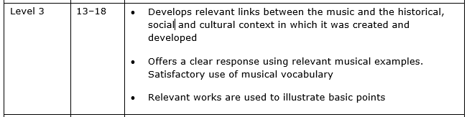
Level 3
For level 3 candidates will give relevant musical background information about the composer, piece and circumstances of composition, which is developed in the essay. There will be some accurate musical vocabulary used to make observations. Musical examples will be given by explanation of their effect. Candidates will make links to other music where piece and composer are named but without discussion to explain and justify the connection.

Slide 25
Candidate responses– level 3
TEMPO, METRE AND RHYTHM
In terms of rhythm, Stravinsky uses off beat accents to put the audience on edge and create an unpredictable menacing mood, especially as it is used in conjunction with relentless continuous quavers in the strings. He does this similarly in the final movement of the work Sacrificial Dance where lower and upper strings intertwine in their syncopated stabs. Stravinsky maintains a steady pulse and tempo giusto throughout which contrasts with other movements of the work which are much more fluid in terms of metre and tempo. The persistent duple time creates a marching effect which helps to emphasise the ballet’s themes of paganism and ritual. Rachmaninov's Symphonic Dances, 1st movement also uses a steady marching pulse.

Slide 26
Candidate responses– level 3
TEMPO, METRE AND RHYTHM
In terms of rhythm, Stravinsky uses off beat accents to put the audience on edge and create an unpredictable menacing mood, especially as it is used in conjunction with relentless continuous quavers in the strings. He does this similarly in the final movement of the work Sacrificial Dance where lower and upper strings intertwine in their syncopated stabs. Stravinsky maintains a steady pulse and tempo giusto throughout which contrasts with other movements of the work which are much more fluid in terms of metre and tempo. The persistent duple time creates a marching effect which helps to emphasise the ballet’s themes of paganism and ritual. Rachmaninov's Symphonic Dances, 1st movement also uses a steady marching pulse.
The candidate identifies features of all three areas of the element and links to the effect created. The off beat accents are described as unpredictable and the continuous quavers as relentless. It is a shame that their reference to other music is vague for the comment on tempo. The reference to the Rachmaninov piece is an illustration rather than a justification as they do not give us any information about that piece to provide a justification.

Slide 27
Candidate responses– level 3
TEXTURE
The texture of the Augurs of Spring is constantly changing to place emphasis on the tribes unpredictable nature. It opens with abrupt homorhythm / homophony, a stark contrast to the monophonic and polyphonic nature of the Introduction. The homophony emphasis every beat and depicts the stamping of the tribe’s ritual. This abrupt homophony can also be found in Schumann’s piano trio in G minor, in the second subject which contrast with the lyrical first subject. In the bar before figure 22 there is a sudden drop from building polyphony to a triplet timpani and pizzicato thump followed by a few beats of silence with a pause. This sudden sparseness after a big textural build up is jarring and gives you the sense that something bad is happening, building up suspense. This sudden pause was also used by Berlioz in an earlier Romantic piece, Symphonie Fantastique, movement 1 in which he writes in 2 bars of silence at around bar 292.

Slide 28
Candidate responses– level 3
TEXTURE
The texture of the Augurs of Spring is constantly changing to place emphasis on the tribes unpredictable nature. It opens with abrupt homorhythm / homophony, a stark contrast to the monophonic and polyphonic nature of the Introduction. The homophony emphasis every beat and depicts the stamping of the tribe’s ritual. This abrupt homophony can also be found in Schumann’s piano trio in G minor, in the second subject which contrast with the lyrical first subject. In the bar before figure 22 there is a sudden drop from building polyphony to a triplet timpani and pizzicato thump followed by a few beats of silence with a pause. This sudden sparseness after a big textural build up is jarring and gives you the sense that something bad is happening, building up suspense. This sudden pause was also used by Berlioz in an earlier Romantic piece, Symphonie Fantastique, movement 1 in which he writes in 2 bars of silence at around bar 292.
This candidate identifies the homophonic texture, with rather a vague reference to monophonic and polyphonic texture in the Introduction. The other music connection isn’t clear whether it is Clara or Robert Schumann’s piano trio, but we can take this as a correct link to the set work. The polyphony before the silence isn’t correct and there is no need to refer to locations in the score. The pause and the effect of silence is correct, and it does not matter that it is in the mark scheme under the tempo, metre and rhythm element. The connection is more of an illustration as the justification is not correct, being over 3 bars of silence and no bar number was needed as this was incorrect anyway. This is typical of a level 3 as it is a clear response with satisfactory use of musical vocabulary. Other music choices are relevant but they illustrate rather than showing knowledge of the piece to provide a justification.

Slide 29
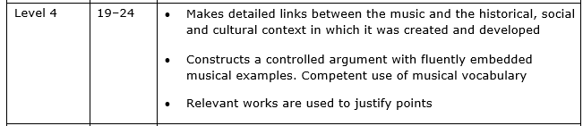
Level 4
A level 4 essay will give detailed musical information about the composer, piece and circumstances of composition, which is developed in the essay. There will be use of musical vocabulary applied to musical observations about the elements in the question. Explanation of the effect will be given during the essay and with discussion to provide a controlled and balanced account of the set work. Candidates will make links with other relevant music, showing explanation and knowledge of the linked piece in their discussions to provide a justification.

Slide 30
Candidate responses– level 4
TEMPO, METRE AND RHYTHM
Rhythm, tempo and metre is probably the single most important element in The Augurs of Spring. From the beginning an insistent continuous quaver ostinato underpins the music, similar to the snare drum ostinato used throughout Ravel’s Bolero. The quavers are emphasised with stamping, irregular use of accents which obscure the metre and make it hard to tell where the strong and weak beats would be and may have inspired Prokofiev who used similar accents in his 1916 piece Dance of the Pagan Monster. These rhythms both evoke a feeling of primal energy that Stravinsky managed to harness in the Rite of Spring. Later the violins have developed a form of the quaver ostinato, using rushing semiquavers instead and the rhythmic diminution further adds to the excitement. Steiner’s score to King Kong uses rhythmic diminution in a similar way to build tension. The Augurs of Spring has a frantic fast tempo and 2/4 time signature that maintain momentum as well as scurrying triplets that can be found across all movements.

Slide 31
Candidate responses– level 4
TEMPO, METRE AND RHYTHM
Rhythm, tempo and metre is probably the single most important element in The Augurs of Spring. From the beginning an insistent continuous quaver ostinato underpins the music, similar to the snare drum ostinato used throughout Ravel’s Bolero. The quavers are emphasised with stamping, irregular use of accents which obscure the metre and make it hard to tell where the strong and weak beats would be and may have inspired Prokofiev who used similar accents in his 1916 piece Dance of the Pagan Monster. These rhythms both evoke a feeling of primal energy that Stravinsky managed to harness in the Rite of Spring. Later the violins have developed a form of the quaver ostinato, using rushing semiquavers instead and the rhythmic diminution further adds to the excitement. Steiner’s score to King Kong uses rhythmic diminution in a similar way to build tension. The Augurs of Spring has a frantic fast tempo and 2/4 time signature that maintain momentum as well as scurrying triplets that can be found across all movements.
The candidate identifies several features of this element and often describes the effect of the feature, for example insistent quavers and explaining the effect caused by the irregular accents. Some relevant examples of other music are included. The example of Ravel’s Bolero is a justification as they show some knowledge of the piece and why they made that link. The link to the Prokofiev is an illustration as they do not justify the connection and simply say it is similar. Rhythmic diminution was not a correct observation and therefore the link to King Kong cannot receive credit. They cover aspects of the tempo, metre and rhythm in their paragraph which creates a balanced paragraph. This would be a Level 4 response with a controlled account of this element with explanations of the effect created. There are some relevant works used with one as a successful justification and the other as an illustration, although lacking connection with other music towards the end of the paragraph. This candidate had written a relevant and quite detailed contextual introduction at the start of the essay.

Slide 32
Candidate responses– level 4
HARMONY
Harmony is prevalent in the Augurs of Spring where bitonality is used to create suspense. The iconic opening stamping chords are formed from dissonant interlocking Eb7 and Fb major chords which continues for 18 of the first 22 bars of the movement. This polytonality is gradually increased with the layering of ostinato resulting in the climax of the section. This can be seen in Bartok’s Concerto for Orchestra whose 2nd movement Game of Pairs opening with 2 bassoon solos in bitonality. Furthermore, Stravinsky creates contrast in the Augurs through parallel harmonies where the 4 muted trumpets play parallel 7th chords. This is similar to Debussy’s Prelude a l’apres midi d'un faune which uses parallel chords but in the strings to portray a gentle and mysterious atmosphere.

Slide 33
Candidate responses– level 4
HARMONY
Harmony is prevalent in the Augurs of Spring where bitonality is used to create suspense. The iconic opening stamping chords are formed from dissonant interlocking Eb7 and Fb major chords which continues for 18 of the first 22 bars of the movement. This polytonality is gradually increased with the layering of ostinato resulting in the climax of the section. This can be seen in Bartok’s Concerto for Orchestra whose 2nd movement Game of Pairs opening with 2 bassoon solos in bitonality. Furthermore, Stravinsky creates contrast in the Augurs through parallel harmonies where the 4 muted trumpets play parallel 7th chords. This is similar to Debussy’s Prelude a l’apres midi d'un faune which uses parallel chords but in the strings to portray a gentle and mysterious atmosphere.
The candidate identifies several features of the harmony, sometimes explaining the effect created and at other times not. Examples of other music are relevant and they show signs that they know why they have selected this piece and the moment that they are referring to, but the explanation is unclear. They have gone further than simply naming the piece, as an illustration, but they are only just beginning to attempt to justify the connection. This candidate had written a relevant contextual introduction with some detail at the start of the essay.

Slide 34
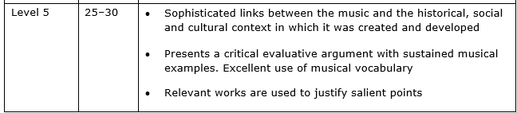
Level 5
In a level 5 essay candidates will give musical background information to the composer and piece and develop this throughout the essay in a sophisticated way in discussion with the elements, musical observations and explanations. There will be excellent use of musical vocabulary which is fluently applied to musical observations about the elements in question and with explanations of the effect explained throughout the essay to provide a thorough and evaluative account of the set work. They will identify the most important musical features to make links with other relevant music, showing explanation and knowledge of the linked piece in their discussions to provide a justification. The mark scheme allows for full differentiation, designed to reward work across the full spectrum of achievement.

Slide 35
Candidate responses– level 5
HARMONY
Stravinsky portrays the barbaric, pagan stampede of the dancers through an interlocking, dissonant, Fb / Eb⁷ bitonal repeated chord in the divisi strings. Stravinsky similarly seeks to depict Petrushka’s character in the end tableaux of the 1911 ballet Petrushka through a bitonal C major / F# major chord first voiced vertically in the piano and then in arpeggios. Stravinsky also takes influence from the impressionistic composer Debussy, who he knew and respected, with the brightly optimistic parallel 4ths and quartal harmony heard in the clarinets accompanying the diatonic alto flute melody, whilst also using groaning deep parallel chords in the horns, directly reflecting Debussy’s use of descending parallel chords in the strings to reflect the clouds in Nuages from Nocturnes. We can also see the use of parallel harmony in Vaughan Williams Bredon Hill from On Wenlock Edge alternating between parallel A minor⁷ and D minor⁷ chords to depict the distant tolling of bells.

Slide 36
Candidate responses– level 5
HARMONY
Stravinsky portrays the barbaric, pagan stampede of the dancers through an interlocking, dissonant, Fb / Eb⁷ bitonal repeated chord in the divisi strings. Stravinsky similarly seeks to depict Petrushka’s character in the end tableaux of the 1911 ballet Petrushka through a bitonal C major / F# major chord first voiced vertically in the piano and then in arpeggios. Stravinsky also takes influence from the impressionistic composer Debussy, who he knew and respected, with the brightly optimistic parallel 4ths and quartal harmony heard in the clarinets accompanying the diatonic alto flute melody, whilst also using groaning deep parallel chords in the horns, directly reflecting Debussy’s use of descending parallel chords in the strings to reflect the clouds in Nuages from Nocturnes. We can also see the use of parallel harmony in Vaughan Williams Bredon Hill from On Wenlock Edge alternating between spread A minor7 and D minor7 chords to depict the distant tolling of bells.
In this response the candidate focusses on the indicative content of dissonant, Fb and Eb⁷ bitonal chords with the effect described and related to the storyline. They link to Stravinsky’s Petrushka and don’t just name the piece but show knowledge of the piece – this is a successful justification. They go on to write about parallel harmony and chords built on 4ths with two examples of other music and knowledge shown of those pieces. We encourage candidates to put their knowledge of other set works to good use in the essays. This is a thorough response packed full of musical vocabulary with relevant works used to justify salient points. They had a detailed contextual introduction and sophisticated links made elsewhere in the essay.

Slide 37
Candidate responses– level 5
TEXTURE
Stravinsky’s use of texture starts with the strong homorhythmic block chords in divisi strings and sudden offbeat horn stabs indicating the violence and chaos of the dance. Later the film composer Leonard Bernstein, who described the Rite of Spring as Pre-historic jazz, used thrilling unison percussion and brass stabs to illustrate the danger of New York in the percussive fugue from the 1954 On the Waterfront Main Title. Stravinsky also uses moments of dense orchestral polyphony with chirping flute quaver figures soaring over syncopated semiquavers in the violins whilst the cantabile trumpets play a diatonic folk melody. Made up of layered repeating ostinato, this can be likened to the Minimalist composer John Adams piece Short Ride in a Fast Machine. Here Adams establishes a crotchet pulse in the woodblock over which a rapid three note ascending ostinato occurs in the clarinet, syncopated repeated trombones and a scalic screeching piccolo.

Slide 38
Candidate responses– level 5
TEXTURE
Stravinsky’s use of texture starts with the strong homorhythmic block chords in divisi strings and sudden offbeat horn stabs indicating the violence and chaos of the dance. Later the film composer Leonard Bernstein, who described the Rite of Spring as Pre-historic jazz, used thrilling unison percussion and brass stabs to illustrate the danger of New York in the percussive fugue from the 1954 On the Waterfront Main Title. Stravinsky also uses moments of dense orchestral polyphony with chirping flute quaver figures soaring over syncopated semiquavers in the violins whilst the cantabile trumpets play a diatonic folk melody. Made up of layered repeating ostinato, this can be likened to the Minimalist composer John Adams piece Short Ride in a Fast Machine. Here Adams establishes a crotchet pulse in the woodblock over which a rapid three note ascending ostinato occurs in the clarinet, syncopated repeated trombones and a scalic screeching piccolo.
In this paragraph the candidate writes about homorythmic chords and off beat stabs with the effect described. They link this to Bernstein’s On the Waterfront with a nice contextual quote. They then write about the polyphony and then then the ostinato suitably linked to a Minimalist piece, Short Ride in a Fast Machine. They show knowledge of both pieces to justify their connection. They have identified the salient points of the element and have made connections with other music. They had a detailed contextual introduction and sophisticated links made throughout the essay.

Slide 39
Question 6 summary
Allow enough time to write and plan the essay (at least 40 minutes)
Divide the 40 - 45 mins up and know how long to spend on each paragraph: the contextual introduction and each of the three elements
Choose carefully from the 4 essays
Organise the essay into clear paragraphs for each musical element
Include relevant contextual information
Cover the three elements fully
Learn features of the musical elements of the set work in advance
Link other music to the elements and main musical features
Be precise when naming the piece, composer and movement of other music
Work out which examples of wider listening to use in advance
Practise writing the introductory contextual paragraph about the composer and piece in advance.
The scores provided for Question 6 are only a helpful reminder and represent a third of the piece/movement. Do not spend time in the exam analysing and working through the score as this will use up a lot of time. It is not the time for score analysis, it is the time to write what you have learnt about the piece as a discussion. It is sensible to learn the main musical features of the piece before the exam.
Do not quote bar numbers in the essay, this is not required and will take up time
Practise creating a musical discussion: identifying a musical feature, explaining it musically and the effect that it creates, linking it with another piece of music and showing some knowledge of that piece by explaining the connection.
Examples of other music should appear consistently throughout the essay and be well represented for each element and connected to as many musical features as possible.
Try to justify the example of other music by writing a small amount of information to musically describe the example and show why it is a good example. Simply naming the piece provides only an illustration

